Slide 1
Module 2
Cognitive Computing

Slide 2
Cognitive Computing
Def:- Cognitive computing is a technology approach that enables humans to collaborate with machines.
A cognitive system uses the data to train, test, or score a hypothesis.
Cognitive computing is the use of computerized models to simulate the human thought process in complex situations where the answers might be ambiguous and uncertain.

Slide 3
Cognitive Computing
With cognitive computing, we are bringing together two disciplines:
Cognitive Computing = Cognitive Science + Computer Science
■ Cognitive science—The science of the mind.
■ Computer science—The scientific and practical approach to computation and its applications. It is the systematic technique for translating this theory into practice.

Slide 4
What are the basic Principles of Science of Mind?
The Principles of Science of Mind articulate the basic ideas of the theory and philosophy of the Science of Mind. The Principles help us understand the Nature of Reality – the Infinite Presence and the Universal Law, the nature of creation and our place in it, and who we are in the scheme of things.

Slide 5
Cognitive Computing
Cognitive computing is an attempt to have computers mimic the way the human brain works. To accomplish this, cognitive computing uses artificial intelligence (AI) and other underlying technologies
Expert systems.
Neural networks.
Machine learning.
Deep learning.
Natural language processing (NLP).
Speech recognition.
Object recognition.
Robotics.

Slide 6
Cognitive Computing
cognitive computing systems must have the following attributes:
1> adaptive
2> interactive
3> iterative and stateful
4> contextual

Slide 7
Cognitive Computing
A cognitive system has three fundamental principles as described below:
1> Learn:- The system leverages data to make inferences about a domain, a topic, a person, or an issue based on training and observations from all varieties, volumes, and velocity of data.
2> Model :- To learn, the system needs to create a model or representation of a domain (which includes internal and potentially external data) and assumptions that dictate what learning algorithms are used.
3> Generate Hypothesis:- A cognitive system assumes that there is not a single correct answer. The most appropriate answer is based on the data itself.

Slide 8
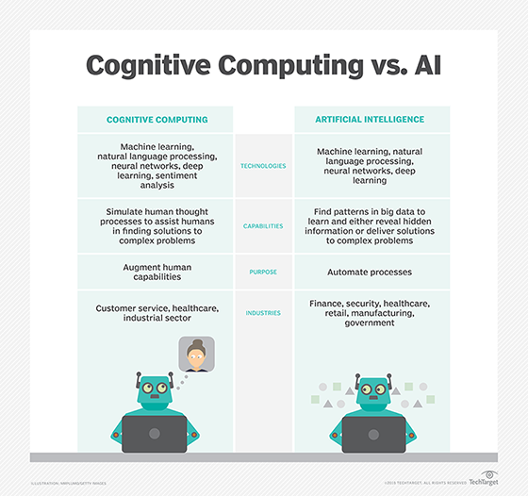
Cognitive Computing Vs AI

